Slide 1


An Ontology-Based Metalanguage with Explicit Instantiation
naam
Committee:
Dr. Ivan Kurtev
Dr. Ir. Klaas van den Berg
Arda Goknil, Msc
Alfons Laarman

Slide 2
Overview
Introduction
  Title
Problem Statement
Approach
The Metalanguage OGML
Results
Conclusion

Slide 3
Introduction (Title)
An Ontology-Based Metalanguage with Explicit Instantiation
Model Driven Engineering

Slide 4
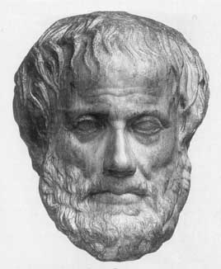
Introduction (Ontology)
Ontology is the study of existence
Uses Observation & Logic
Existential dependence & metaphysical realism

Slide 5
Introduction (Model Driven Engineering)
In a model we capture the state of affairs in a domain of interest
Instantiation / instanceOf
A UML model:
Models raise the level of abstraction in software development

Slide 6
Introduction (Model Driven Engineering)
Models can be used to automate software development
Model transformation
taken from OMG/MDA Guide 03

Slide 7
Introduction (Model Driven Engineering)
A model is expressed in a modeling language
A modeling language consist of concrete syntax, abstract syntax and semantics
A modeling language makes an ontological commitment
A modeling language can be represented as model

Slide 8
Introduction (Model Driven Engineering)

Slide 9
Introduction (Model Driven Engineering)
Modeling architecture
General-purpose
or domain-specific?
Support for multiple modeling languages is desirable

Slide 10
Introduction (Model Driven Engineering)
Metamodeling is the
practice of defining a
modeling language
A metalanguage
is introduced to define
Metamodels (MOF)

Slide 11
Problem statement

Slide 12
Problem Statement
Tradition modeling architectures do not
provide sufficient support for metamodeling
It lacks:
Support for data translation
uniform model handling

Slide 13
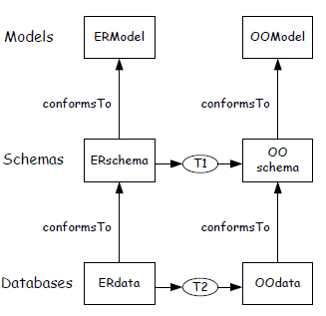
Problem Statement (the problems)
data translation: uniform model handling:
The OCL specification only supports UML and MOF
Taken from Kurtev 08

Slide 14
Problem Statement (an analysis)
We found two sources of the problems:
Multiple instanceOf relations (relativity)
The expressiveness of the metalanguage is imprecise

Slide 15
Problem Statement (an analysis)
Multiple instanceOf: Relativity:
MOF Class
UML Class
MOF Object

Slide 16
Problem Statement (an analysis)
expressiveness of metalanguage:
Guizzardi,Wand & Webber looked at the ontological
faithfulness of UML and concluded that it suffers from:
Construct excessiveness, overload and incompleteness
MOF uses the same constructs as UML and is thus unsuitable to express the ontological commitment of modeling languages

Slide 17
Problem Statement (research questions)
How to provide an uniform interpretation of the instanceOf relation in the whole modeling architecture?
How to ensure precise and consistent definition of metamodels?

Slide 18
Approach

Slide 19
Approach
Define a metalanguage which can express the instantiation semantics
Base the language constructs on Ontology

Slide 20
The Metalanguage OGML
Ontology Grounded MetaLanguage

Slide 21
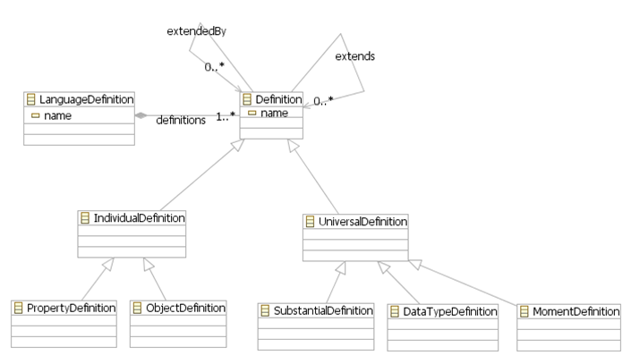
The Metalanguage: OGML
Ontological Constructs

Slide 22
The Metalanguage: OGML
Example Exercise. Express in OGML:

Slide 23
The Metalanguage: OGML
Example
Language SimpleUML {
SubstantialDefinition Class {
...
}
DataTypeDefinition UMLDataType {
...
}
MomentDefinition Attribute {
...
}
ObjectDefinition Object {
...
}
ObjectDefinition Literal {
...
}
PropertyDefinition Slot {
...
}
}

Slide 24
The Metalanguage: OGML
Ontological Relations

Slide 25
The Metalanguage: OGML
Example

Slide 26
The Metalanguage: OGML
The definition of instantiation semantics
(with the use of OCL)

Slide 27
The Metalanguage: OGML
Example

Slide 28
Relations UMLInstanceOfDefinition {
c : Class -> o : Object {
...
} when (not(c.isAbstract))
a : Attribute -> s : Slot {
...
}
}

Slide 29
The Metalanguage: OGML
Example

Slide 30
The Metalanguage: OGML
Ontological Perspective
Example

Slide 31
How to define the perspective in the metamodel?
Ontology tells us about the nature of
relations: each participant has its own
view on the relation
Attribute Function

Slide 32
The Metalanguage: OGML, Attribute function
a : Attribute -> s : Slot {
attributes {
naming name <- a.name;
valuing [a.lowerbound .. a.upperbound] s.value;
typing a.type;
}
}
}
Example

Slide 33
The Metalanguage: OGML :
Reflection
Since OGML is a language to define
languages, we can apply reflection
What is the ontological commitment for the models?
SubstantialDefinition Definition {
attribute name : "String";
}
SubstantialDefinition "SubstantialDefinition" extends UniversalDefinition {}
SubstantialDefinition "MomentDefinition" extends UniversalDefinition {}
SubstantialDefinition "DataTypeDefinition" extends UniversalDefinition {}
SubstantialDefinition IndividualDefinition extends Definition {}
SubstantialDefinition "ObjectDefinition" extends IndividualDefinition {}
SubstantialDefinition "PropertyDefinition" extends IndividualDefinition {}
SubstantialDefinition LanguageDefinition {
attribute definitions [*] : Definition, "Relations", "GeneralizationRelation";
}
...

Slide 34
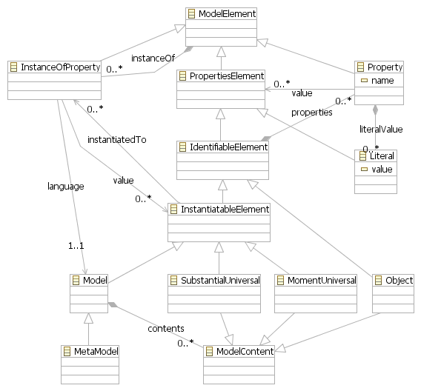
The Metalanguage: OGML, Reflection

Slide 35
The Metalanguage: OGML :Reflection
Relations OGMLInstanceOfRelation {
abstract Definition -> PropertiesElement {... }
sd : UniversalDefinition -> su : InstantiatableElement {... }
md : "MomentDefinition" -> mu : MomentUniversal {... }
"PropertyDefinition" -> XObject {}
"SubstantialDefinition" -> SubstantialUniversal {}
"DataTypeDefinition“ -> SubstantialUniversal {}
"ObjectDefinition" -> XObject {}
"Class" -> XObject {}
"OGMLDataType" -> Literal {}
InstanceOfRelation -> InstanceOfProperty {}
ld : LanguageDefinition -> mm : MetaModel {... }
a : Attribute -> p : Property {... }
i : InherenceRelation -> p : Property {... }
c : CharacterizationRelation -> p1 : Property {... }
c : CharacterizationRelation -> p2 : Property {... }
g : "GeneralizationRelation" -> p1 : Property {... }
g : "GeneralizationRelation" -> p2 : Property {... }
}

Slide 36
Results

Slide 37
Results
To verify that OGML works we created a prototype of the language
We conducted case studies and expressed different kinds of UML
The OCL engine was used to show that models can be uniformly handled (navigated)
We proved that models are instanceOf OGMLX

Slide 38
Results: Navigating N-ary Associations
Player | Team | Year | salary
Davids | TWENTE | 1999 | 1000000
Kluivert | TWENTE | 2000 | 100000
Davids | AJAX | 1997 | 200000
Kluivert | AJAX | 1998 | 500000
{UML |
UMLMM!Player.allInstances()->collect(ps | ps.player->collect(ac |
'Player '+ ac.player.name +' played in team '+ ac.team.name +
' during '+ inYear.year +' for the mere sum of $'+ ac.salary))
->iterate(row ; result: String = '' | result + row +'\n')
}
Player Davids played in team TWENTE during 1999 for the mere sum of $1000000
Player Kluivert played in team TWENTE during 2000 for the mere sum of $100000
Player Davids played in team AJAX during 1997 for the mere sum of $200000
Player Kluivert played in team AJAX during 1998 for the mere sum of $500000

Slide 39
Results: Navigating explicit relativeness
{OGML|
UMLM!Kluivert->first().attributes
}
{OGMLX|
UMLM!Kluivert->first().properties
}

Slide 40
The Metalanguage: OGML
Proof of Uniform model representation
OGML constructs are defined self-reflectively
+ InstanceOfDefinitions map OGML to OGMLX constructs
= All models are instanceOf OGMLX
OGMLX stores the ontological meaning of constructs!

Slide 41
The Metalanguage: OGML
Proof of Uniform model representation

Slide 42
Conclusion
OGML can provide uniform handling of models as demonstrated with OCL explicit relativity
OGML provides an explicit ontological commitment for metamodels and models (via OGMLX)
Compared MOF and OWL we are closer to the OWL reification model but preserve more meaning of the constructs

Slide 43
Conclusion
Did OGML trade expressiveness for uniform model handling?
We only expressed a subset of UML, what about RDF, OWL, MOF?
Can this support data translation?
Future Work: investigate expressiveness
Extend OGML with mereology, multiple instantiation

